Slide 1
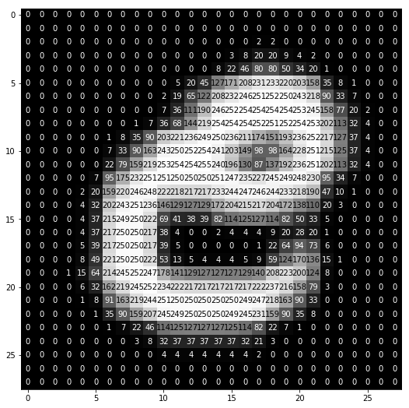
Letter Recognition
Presented by: Sheetal Kumari
Nov 19 cohort batch

Slide 2
Description: To identify each of a large number of black-and-white rectangular pixel displays as one of the 26 capital letters in the English alphabet. The character images were based on 20 different fonts, and each letter within these 20 fonts was randomly distorted to produce a file of 16,000 unique stimuli. Each stimulus was converted into 16 primitive numerical attributes (statistical moments and edge counts) which were then scaled to fit into a range of integer values from 0 through 15.
letter : capital letter (26 values from A to Z)
x-box : horizontal position of box
y-box : vertical position of box
width : width of box
high : height of box
onpix : total # on pixels
x-bar : mean x of on pixels in box
y-bar : mean y of on pixels in box
x2bar : mean x variance
y2bar : mean y variance
xybar : mean x y correlation
x2ybr : mean of x * x * y
xy2br : mean of x * y * y
x-ege : mean edge count left to right
xegvy : correlation of x-ege with y
y-ege : mean edge count bottom to top
yegvx : correlation of y-ege with x

Slide 3
Problem Statement
To identify English Alphabet using Machine Learning Algorithm.
Observations:
Number of rows: 16000
Number of columns: 1 object and 16 integer type
No missing values.

Slide 4
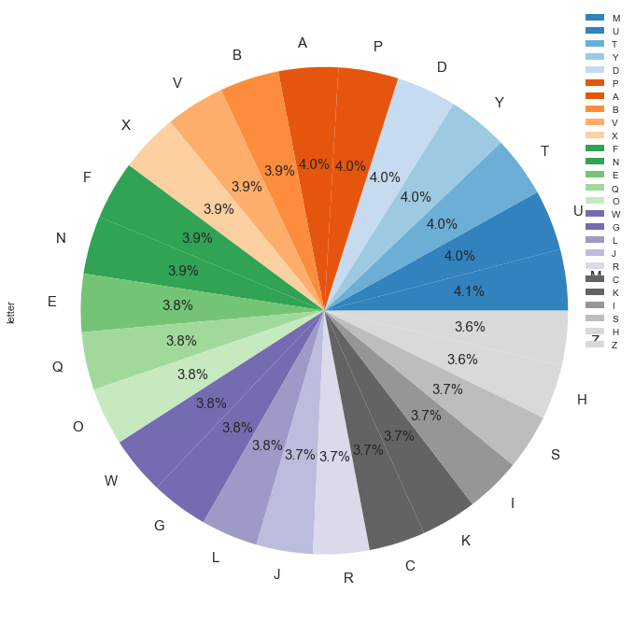
Pie Chart Representing the percentage of each letter in the data

Slide 5
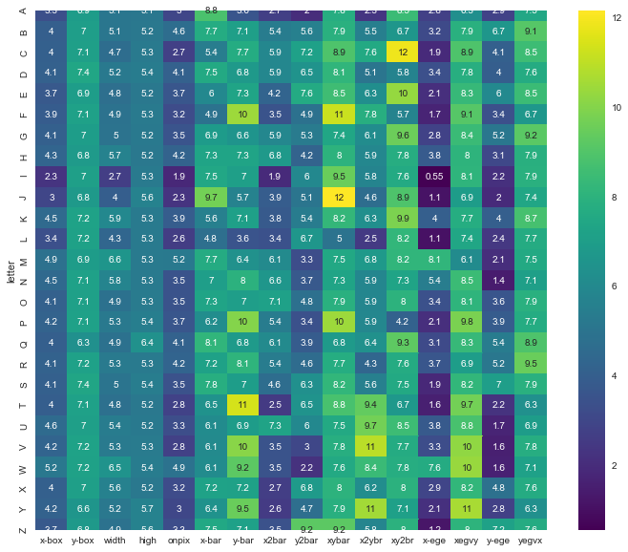
Heat Map

Slide 6
Decision Tree
SVM
Accuracy: 0.8659375
Linear: accuracy: 0.8390625
Non linear : accuracy: 0.93625

Slide 7
Naïve Bayes
KNN
Accuracy: 0.6390625
Accuracy: 0.945625

Slide 8
Conclusion
After applying algorithms the highest accuracy turns out to be 94% in KNN algorithm.

Slide 9


